Slide 1
What is happening in the old local industry? a case study of textile industry in Taiwan
A framework based on comparable cases

Slide 2
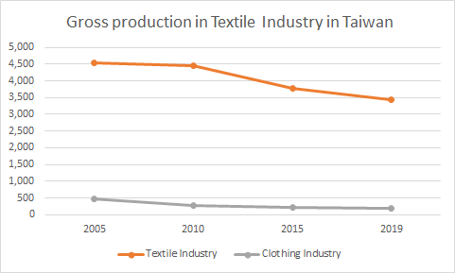
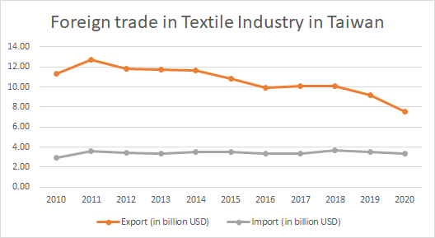
Introduction
The decline of the textile industry in Taiwan
Figure 1 Gross production in Textile Industry in Taiwan
(Source: Adapted from Overview of Textile Industry in Taiwan in 2019. June 2020. Taiwan Textile Federation)
Figure 2 Foreign trade in Textile Industry in Taiwan
(Source: Adapted from https://www.mof.gov.tw)
27.7%
Gross production decreased from 2005 to 2019

Slide 3
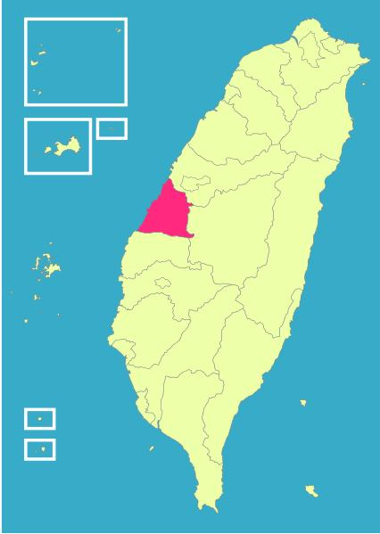
Introduction
Potential support?
IDB in 2019
(industrial development bureau) in the ministry of economics
Executed by: TTRI (Taiwan Textile Research Institute)
Total budget: 75 million NTD
smart manufacturing
integrated resources to optimize the industry development
branding and technology transfer
Hemei Zhen
1st
NT$ 6.8 billion
manufacture of textile products
2nd
NT$ 8 billion
weaving of textiles
Figure 3: Changhua County
(Source: https://taiwan.typepad.com/)
(in total values of production per year in Taiwan)
Notes:
17:35

Slide 4
Literature Review
Search Query
Journal papers: Google Scholar
Theses and dissertations: National Digital Library of Theses and Dissertations in Taiwan (NDLTD)
Data Base
Search Query
("和美" or "Hemei") and ("紡織" or "textile" or "織布" or "weaving" or "weave")
1. Select by title: economic development AND textile industry cluster AND in Hemei Zhan
2. Select by abstract
Selection
 | NDLTD | Google scholar
Result of the searching query | 206 | 639
Candidate after 1st step | 23 | 13
Selected article after 2nd step | 5 | 7
Results
Notes:
Select by title: The title of the article should contain the following 3 topics:
Category: economic development (in a board sense)
Industry: textile industry cluster
Location: in Hemei Zhan
Some of the article seems to relate to these 3 topics, but the keywords are not appeared in the title. In such cases, they were selected, and examined in the 2nd step
Select by abstract: The abstract of the articles filtered from the 1st step are all read and decide if the content is related to the 3 topics mentioned above.

Slide 5
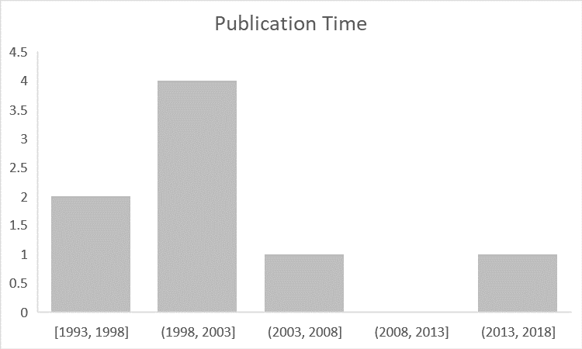
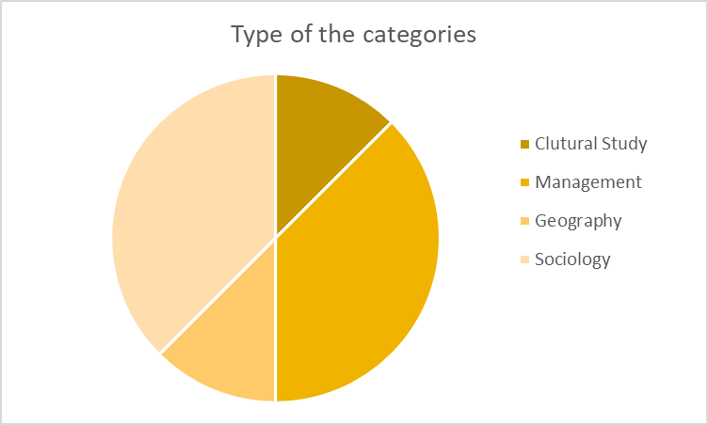
Literature Review
Search result (analysis)
Figure 3 The publication time of the literature review
(Source: Made by this research)
Figure 4 The publication time of the literature review
(Source: Made by this research)
Notes:
17:35

Slide 6
Motivation
Brief scan
Category
1. Cluster quantitative research (2)
management
2. Qualitative research in industry view (3)
management, geography, sociology
3. Qualitative research in society view (3)
sociology, cultural study
Cluster quantitative research
“the degree of networking does play a mediating role between geographic cluster and competitive advantage”
“both degree of networking and betweenness position are conducive to the pursuit of competitive advantage.”
(Lei and Huang, p.852, 2014)
The relationship between the networking ties and other variables, like firms’ quality, flexibility, delivery capability, cost reduction, etc.
(Wen-Chi Hung: 2002)
Notes:
17:35

Slide 7
Motivation
Brief scan
Qualitative research in industry view
Why the firms in textile industry in Hemei Zhan want to invest aboard are due to the reducing labor cost, accessing textile raw material, utilizing old machine, relative low environment regulation.
After 1980s, the textile industry in Hemei get to decline due to the loss of young employee, and also the challenge from China and Southeast Asia. Facing this challenge, most of the firms are not invest aboard, but choice to close the factory, update the equipment, changing producing network, and recruit immigrant labor.
(Chuagu feng chia: 2003)
The decline of the textile industry in Hemei Zhan is due to the firms didn’t catch the mainstream of the development of both the nation and the textile industry.
(Wang, Qiong-Zu: 2000)
(Chieh-Hsuan Chen, p.59, 2001)
Notes:
17:35

Slide 8
Motivation
Brief scan
Qualitative research in society view
The development of the textile industry is strongly related to the local family, which can be observed by the aggregate of the textile industry cluster in some of the tradition inhabited place.
The economic exchange form in this network is “delayed payment” (延緩性支付), which is due to the economic network embedded in the social network, and the profit exchange based on the social relationship (人情).
The raise of textile industry provides the politic power to the family in this industry, which then form the new leader class after the World War II.
(Chao, Hui-Lin: 1993)
The industrialization of the textile industry in Hemei Zhan is more likely to the tradition mindset, which is simply pursuing better economic in household, and the operation logic emphasizing social relationship (人情).
(Wei-guo Jeng: 2004)
(Chen, Jie-Ying: 1997)
Notes:
17:35

Slide 9
Framework
Statement
The phenomenon
Facing the challenges from the deduction of labor cost, and the competing from China and Southeast Asia, the textile industry got restructuring in 1980s. (Wang, Abstract, 2000)
The statement
“In the environment, how the actor reacts to the phenomenon?”
The phenomenon in the statement
“In 1980s, how the textile industry in Hemei Zhan reacts to the industrial restructuring due to the challenges from the deduction of labor cost, and the competing from China and Southeast Asia.”
1. the environment (1980s),
2. the actor (the textile industry in Hemei Zhan)
3. the phenomenon (industrial restructuring).
Notes:
17:35

Slide 10
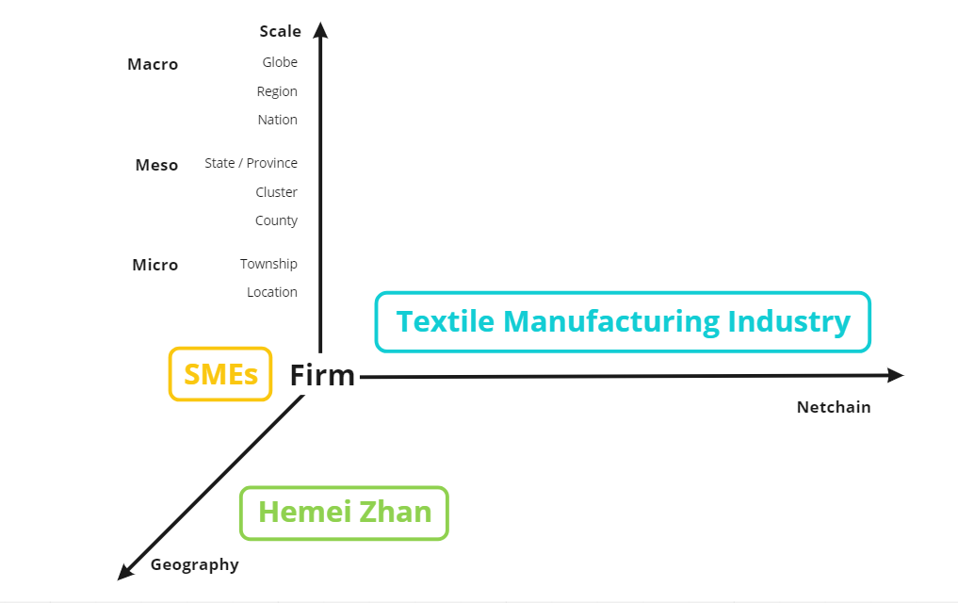
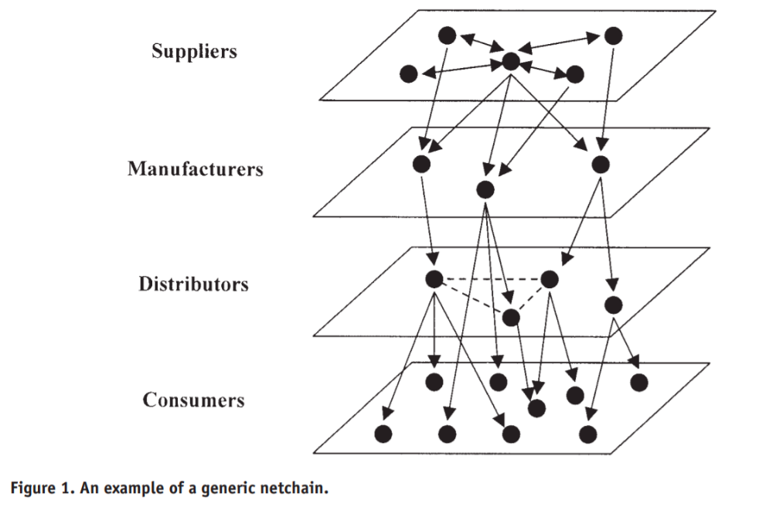
Framework
The actor part
Firm / Geography / Netchain
Figure 5 The idea of netchain
(Source: Lazzarini, S., Chaddad, F., & Cook, M.: 2001)
Figure 6 The 3 dimensions of the actor part
(Source: Made by this research)
Notes:
17:35

Slide 11
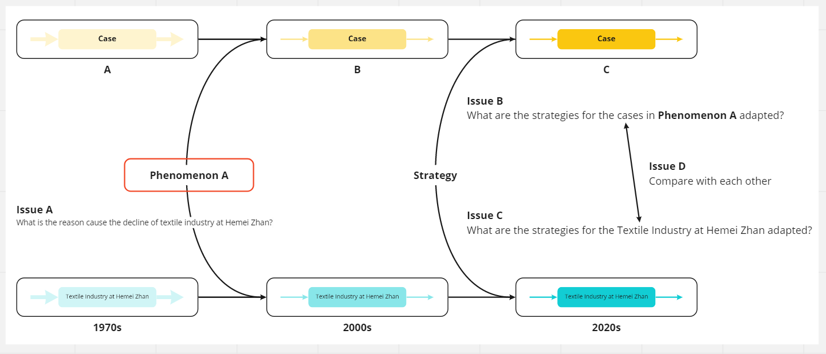
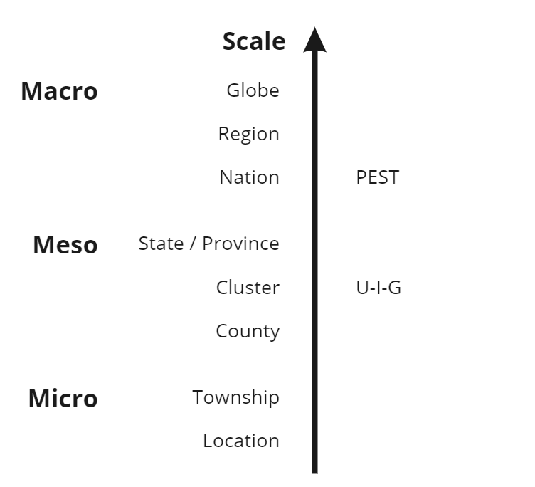
Framework
The environment / phenomenon part
Figure 7 The different scale of the environment
(Source: Made by this research)
Figure 8 The phenomenon between cases
(Source: Made by this research)
Notes:
17:35

Slide 12
The phenomenon
The development stage of the industry in Taiwan
The development of the textile industry in Taiwan
1945
the post-war reconstruction period
In 1950s, the national government use the “import-substitution”.
1953
light industry development
become the 2nd largest export industry in Taiwan.
1973
the development of heavy and chemical industries
1984
the development of strategic industries
In the early 1980s, the textile industry becomes the largest export industry
1991
the development of high-tech industries.
“The issue the textile industry faces when the industry structure changes along the development of the country.”
Notes:
17:35

Slide 13
The environment
For a policy view
Figure 9 The policies from 2000 to 20014
Notes:
17:35

Slide 14
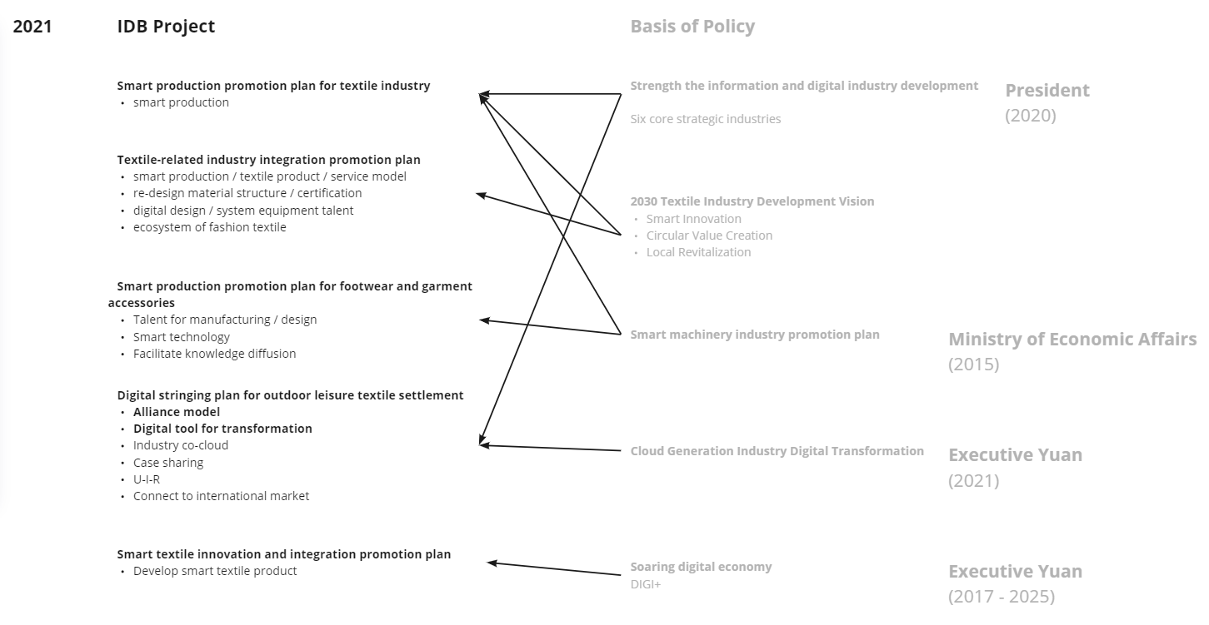
The environment
For a policy view
Figure 10 The IDB project in 2021
Notes:
17:35

Slide 15
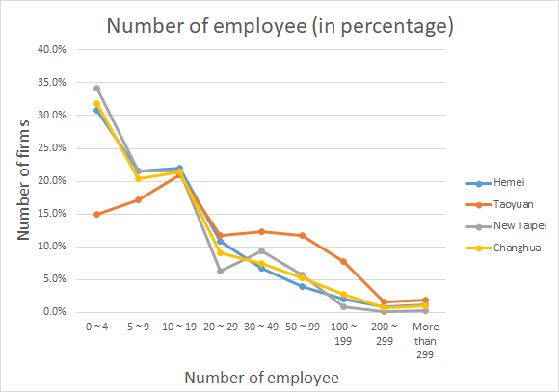
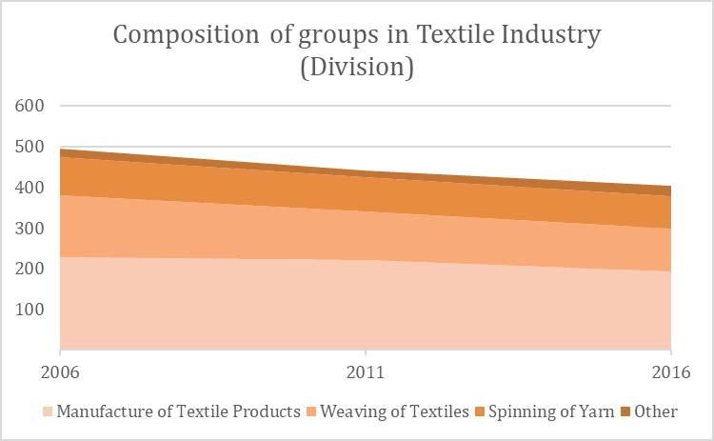
The actor
Firm / Geography / Netchain
Figure 10 The percentage of the firms’ size in the number of employees
(Source: https://www.stat.gov.tw)
Figure 11 The industry composition of groups in Textile Industry
(Source: https://www.stat.gov.tw)
SME
Manufacture of Textile Products
Weaving of Textile
Notes:
17:35

Slide 16
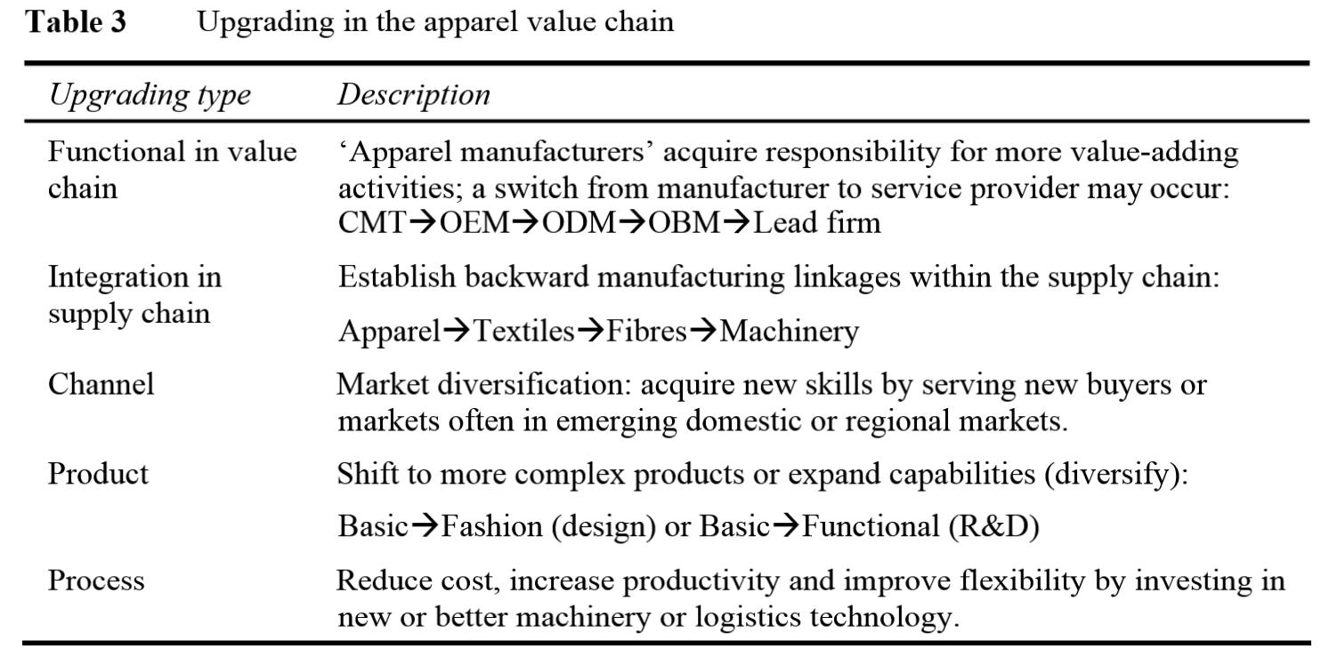
React
Hemei
In 1980s
close the factory
upgrade the equipment
changing producing network
recruit immigrant labor
The Hemei Textile Cultural Park
Table 3 Upgrading in the apparel value chain
(Source: Frederick, S., & Gereffi, G., 2011)
Land issue (2017)
Time issue (2021)
Notes:
17:35

Slide 17
Limitation
✋
🛒
Lack of empirical research
Oversimplifying
Only one short interview with one of the stakeholders in the establishment of the the Hemei Textile Cultural Park
Treat the SMEs in Hemei Zhan as an entity.
Notes:
17:35

Slide 18
Discussion
Macro
Environment
The environmental regulation for the textile industry in Taiwan also influence the decision of the firms in Hemei Zhan. (Chuagu feng chia: 2003)
Meso
Technology
How do the public research institutes like Industrial Technology Research Institute (ITRI), or Textile Technology Research Institute (TTRI) cooperate with the textile industry to produce high-end products, or digitalize the manufacturing process?
Micro
Society
In Chen’s work, it claims that people who operating textile factories in Hemei Zhan switch to firming when the textile market get down. Besides, the reason why they keep the textile business is simply pursuing better economic in household, which is difference from the accumulation logic of the capitalism.
Notes:
17:35

Slide 19
Conclusion
How do we understand the decline of the textile industry in Taiwan
Approach: from a cluster case study.
Literature Review
Out of date
Wang’s industrial restructuring
Framework
In the environment, how the actor reacts to the phenomenon?”
The phenomenon
History
The environment
Policy
The actor
Reaction
the Hemei Textile Cultural Park
Notes:
17:35

Slide 20
Reference
Chinese Books
Chieh-Hsuan Chen [陳介玄]. (2001). *Team and Boss [班底與老闆]. 聯經出版事業公司.
*Chen, Jie-Ying [陳介英]. (1997). *The traditionalization in the industrialization –– a research on the textile industry in Hemei [工業化中的傳統化——和美紡織業之研究]. *Local Society [地方社會]. ? [東海大學東亞社會經濟研究中心主編].
Chinese conference paper
*Tang, Zhi-Hong [唐志宏], *Su,Zhi-Qing [蘇志青]. (2015). ? [破壞中的重建：戰後彰化在地產業的變遷與分期]. [產業論壇‧深化在地產業文化認知學術研討會], [建國科大學].
Chinese Master’s Thesis
Wei-guo Jeng [鄭維國]. (2004). The research of Homei''s textile industry and social transition [和美紡織業與地方社會變遷之研究]. Master’s thesis, 國立臺南大學鄉土文化研究所, Tainan. URL: https://hdl.handle.net/11296/mz63t4
Wen-Chi Hung [洪文琪]. (2002). The Influence of the Networking Ties on Competitiveness of a Firm：An Empirical study of the Firm in the Her-Meei Area [地理群聚內廠商之網絡關係對其競爭力影響之研究-彰化和美地區紡織業之實證]. Master’s thesis, 朝陽科技大學企業管理系, Taichung. URL: https://hdl.handle.net/11296/j8cqkz
Wang, Qiong-Zu [王瓊足]. (2000). *The impact from the industrial re-construction of SMEs to the local －an example of the textile industry in Hemei region. [中小企業產業再結構對地方之衝擊─以和美地區紡織業為例]. Master’s thesis, The Geography Department of National Taiwan Normal University, Taipei. URL: https://hdl.handle.net/11296/e939k9
Notes:
17:35

Slide 21
Reference
Chinese Master’s Thesis
Chao, Hui-Lin 趙蕙鈴. (1993). The content of relationships of "productive networks of ''Shier- Lih'' " of small enterprises in Taiwan ─── The case study of textile industry in Her-Meei [台灣中小型工廠協力生產網絡之關係內容分析──彰化縣和美地區紡織工業之個案研究]. Master’s thesis, 東海大學社會學系, Taichung. URL: https://hdl.handle.net/11296/38384x
Chuagu feng chia [莊豐嘉]. (2003). The Research on Current Investment Situation of Traditional Industry Referring to Spinning Industries in Ho-mei Area [傳統產業『和美織仔』投資現況之研究]. Master’s thesis, 大葉大學國際企業管理學系, Changhua. URL: https://hdl.handle.net/11296/w6k5hy
Journal
Frederick, S., & Gereffi, G. (2011). Upgrading and restructuring in the global apparel value chain: why China and Asia are outperforming Mexico and Central America. International Journal of Technological Learning, Innovation and Development, 4(1-3), 67-95.
Lazzarini, S., Chaddad, F., & Cook, M. (2001). Integrating supply chain and network analyses: the study of netchains. Journal on chain and network science, 1(1), 7-22.
Lei, Han-Sheng, and Chin-Hua Huang. (2014). Geographic clustering, network relationships and competitive advantage: Two industrial clusters in Taiwan. Management Decision .
Ho, J. K. K. (2014). Formulation of a systemic PEST analysis for strategic analysis. European academic research, 2(5), 6478-6492.
Notes:
17:35

Slide 22
Question
Theory B
Debate
Hook
Hook
Back
Result
Back
Result
Frame
Frame
Compare
Frame
Frame
Theory A
1
2
Method
Info
Method
Info
Case A2
Case A1

