Slide 1
An Assessment of transformation and upgrading of tea industry in Fujian
Zoe Chen
2021.12.21
Notes:
Good evening, everyone, I am Zoe. Today I want to have a brief presentation of my research topic——an assessment of transformation and upgrading of tea industry in Fujian.

Slide 2
contents
Research background
Research questions and objectives
Literature review
Preliminary Analysis
Research methods
References
Notes:
Here is my contents, I have divided it into 5 main parts.

Slide 3
Research backgrounds
Overview Of Tea Industry
Long History
China was the first country to cultivate tea and consume tea leaves
Originated in the Han Dynasty, and flourished in the Song Dynasty
Research field
Industrial development
Work as one of the essential industries for rural villages to promote economic development
Tea cultivation, tea production, tea processing
Tea import and export trade, tea comprehensive utilization, tea culture construction
Notes:
First of all, let's begin with the research background. The development of the tea industry can be broadly summarized into three main aspects.
Tea as one of the three most consumed non-alcoholic beverages in the world, originated in China. China was the first country in the world to grow tea and consume tea, which developed in the Han Dynasty and flourished in the Tang and Song Dynasties, with a history of more than 1600 years.
The scientific research on the tea has changed from tea cultivation, tea production, tea processing to the import and export trade, comprehensive utilization and the construction of tea culture.
In some provinces of China, the cultivation of tea has become an economic development industry in rural areas, further promoting the development of China's tea industry.

Slide 4
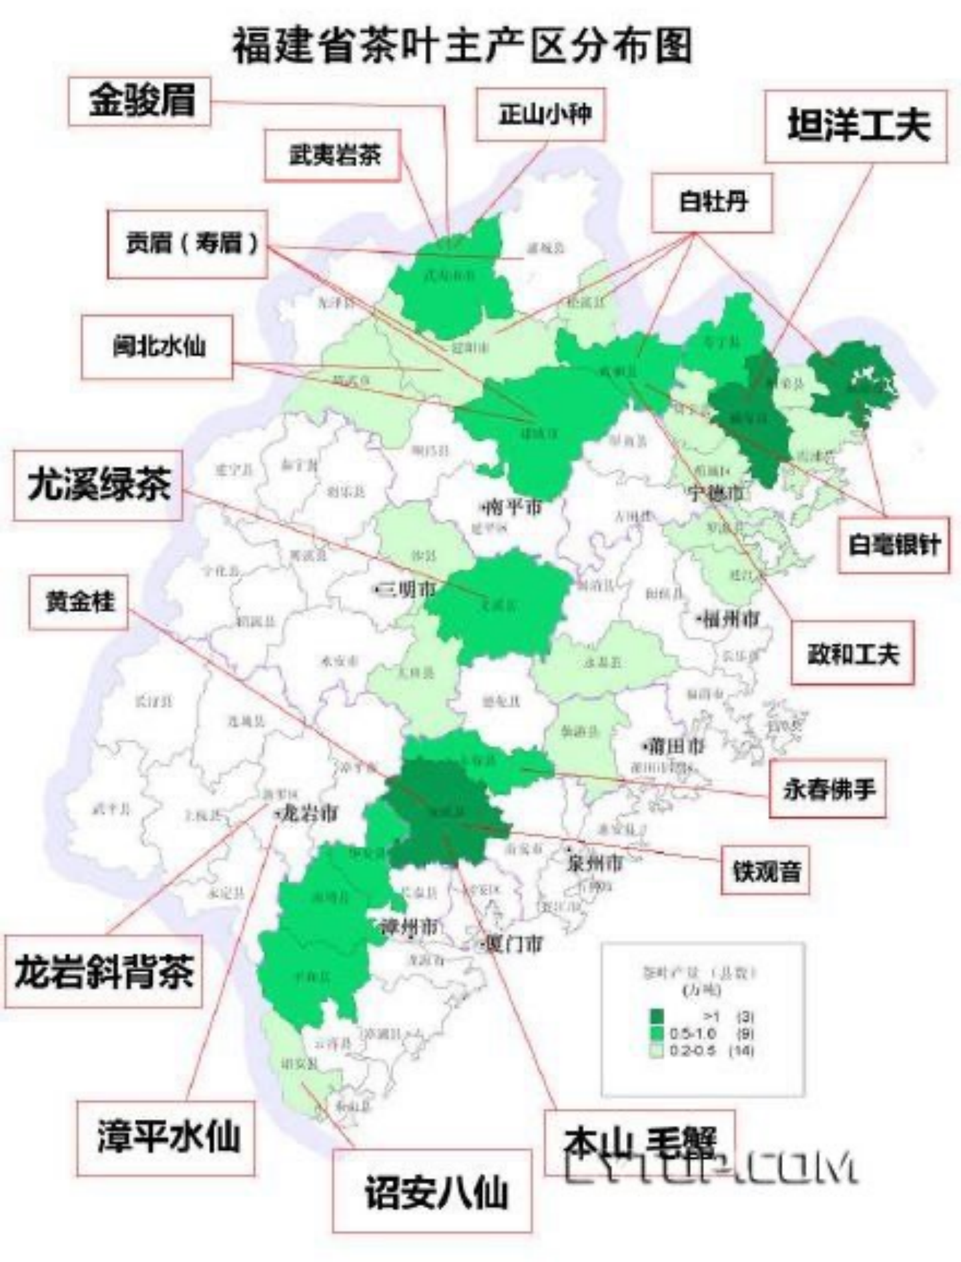
Research backgrounds
Overview Of Tea Industry in Fujian
Fujian (the South China tea-producing area)
Most suitable area for tea tree growth in China
Hometown of Oolong tea in the world
One of the nine pillar industrials in Fujian
Distribution of Tea Production in Fujian
From： Map of Fujian Tea Origin
Source: statistical office of FUJIAN，2021.03
Notes:
Next, we are going to concern about the development of Fujian tea industry. In terms of regional distribution, there are four major tea producing regions in China, with Fujian as the representative of the tea producing region in southern China, which is the most suitable area for the growth of tea trees in China. Fujian has a superior natural and economic environment for tea cultivation, production, processing and trading. Fujian is also known as "the hometown of oolong tea in the world", and Wuyi Rock Tea, Anxi Tieguanyin, Tangyang Kungfu Tea, Fuding White Tea are all well known at home and abroad. As the most widely distributed economic crop in Fujian, tea industry is one of the nine pillar industries in Fujian.
According to the data from statistical office of FUJIAN, tea production in Fujian has been increased continuously from 2011 to 2020. In 2020, the tea output of Fujian Province was 461000 tons, accounting for 18% of the country, and the total output value of the tea industry will be nearly 90 billion RMB, ranking first in the country in terms of output and value. In the international market, the export volume of tea in Fujian is stable at about 25,000 tons, and the export value of tea in Fujian was $455 million dollars in 2019 and $418 million dollars in 2020, ranking the top three in China.

Slide 5
Tea Industry in Fujian
Three Major Changes (Ancient road Ruigong Pu'er Tea Mall, 2011)
the traditional planting industry modern industry or modern service industry
the single operation of tea industry the diversified operation of the tea industry
the pure quantity expansion type cultural connotation value-added type of industry
Challenges
Industrial chain: the standardized, regulated, and large-scale tea production chain has not yet been
R & D: weak independent R & D ability and awareness
Macro perspective: consumption is not flexible enough, the effective demand for tea is relatively small
Notes:
At present, the development of tea industry in Fujian are making efforts on achieving “three major changes”, from the traditional farming industry to the modern industry or modern service industry, from the single operation of tea industry to the diversified operation of tea industry, from the pure quantity expansion type to the cultural connotation value-added type of industry.
Although Fujian's production factors and other resource advantages are competitive to the development of tea industry, its sustainable development has also encountered a bottleneck and is unable to guarantee its competitive advantage in the market. From the perspective of the industrial chain, a standardized and large-scale tea production chain has not yet been formed; from the perspective of research and development, most traditional tea companies are relatively weak in independent research and development, and are not very capable of scientific research and transformation to meet the innovation and diversification of products; from the macro perspective, the consumption is not flexible enough, the per capita consumption of tea is very low, and there is excess productivity, with the difference of 20% .

Slide 6
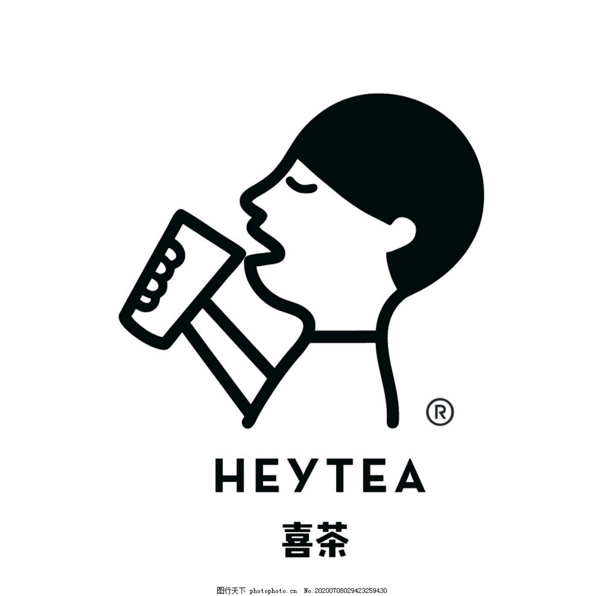
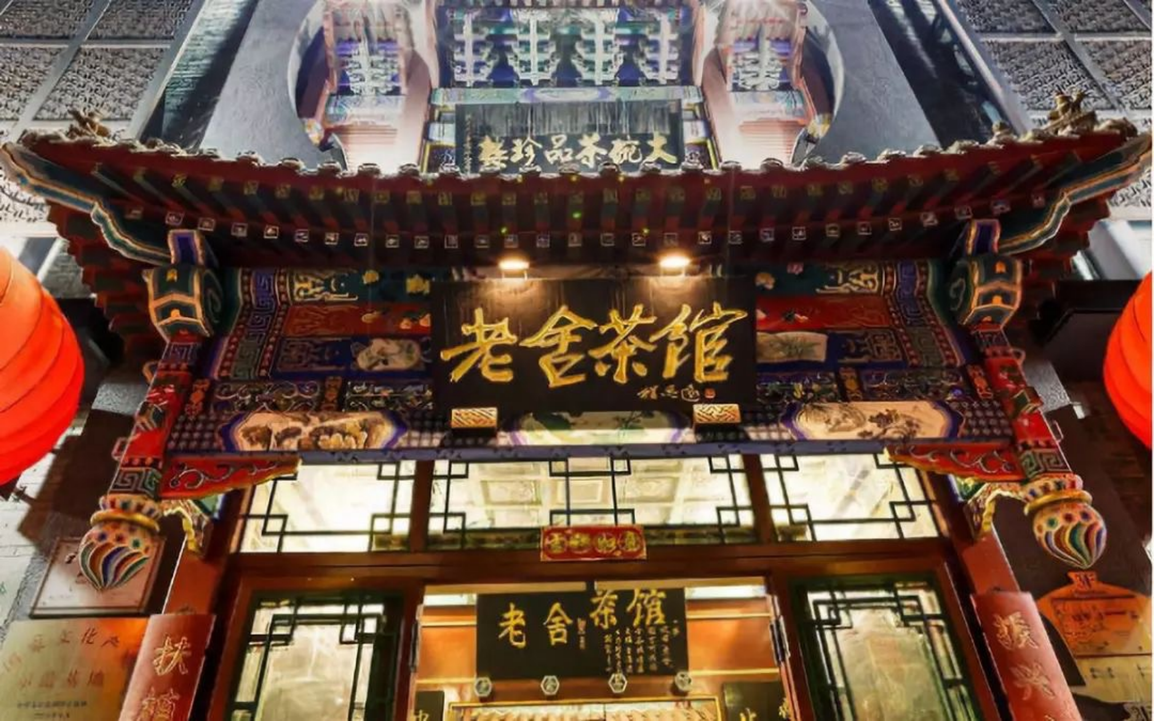
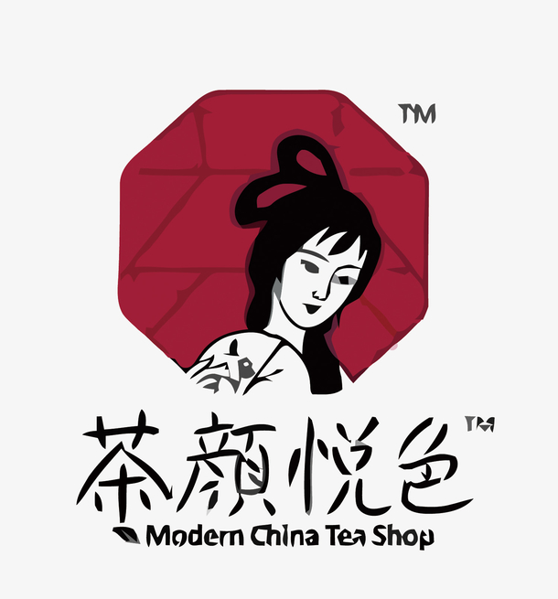
Research backgrounds
Compare with other provinces or cities
Notes:
Looking at the development of the tea industry in Guangdong as the main tea producing area and Shanghai, Hangzhou and Beijing working as the main tea consuming areas, some innovations have been made in the value-added of its industrial chain.
Driven by the upgrading of consumption, the new tea beverages has become a new choice for the young generation to consume tea in recent years. Guangdong's HeyCha, Naiyuki's Tea and Cha Yen in hunan are the representatives of the new tea beverages.
The popularity of teahouse business in Shanghai, Sichuan and Zhejiang is a typical representative of the cultural value attached to the tea industry, and the characteristics of the service industry of teahouse business have exceeded the nature of the manufacturing industry.

Slide 7
Research questions and objectives
Research questions
Is transformation and upgrading existed in Fujian tea businesses?
If yes, how was the transformation and upgrading process developed?
Research Objectives
Although the resource advantages of Fujian's tea production factors are still important and competitive, they can no longer guarantee the sustainable competitive advantage of Fujian's tea industry
In the international market where the domestic tea market demand is relatively stable, and the supply exceeds the demand, maintaining and further improving the global competitiveness of the tea industry in Fujian.
Notes:
All in all, in the current global tea market, Fujian's tea industry is facing opportunities and challenges, as well as advantages and shortcomings. In a relatively stable demand and over-supply environment in the domestic tea market and international market respectively, how to maintain and further improve the international competitiveness of Fujian's tea industry is an urgent issue to be solved.
Therefore, the question of this research is whether transformation and upgrading existed in Fujian tea businesses?
If yes, how was the transformation and upgrading process developed?

Slide 8
Literature review
Agricultural Industry
Industry Transformation
Smile Curve Theory
Agricultural Economy and Market Performance （Wang Zhaoyang, 2007）
Agro-industrial chain and industrial tea chain
（Mighell and Jones ,1963)
(Schiebel W, 2001)
Industry Development Theory (Zhang Huiheng, 2004)
Industrial Transformation and Industrial Upgrading Theory (Erickson, 1996) (Gary, 1999)
Industrial competitiveness Theory (Porter's Diamond Theory Model)
Business Model Transformation
Smile Curve Theory
(Stan Shih ,1992)
Value Chain Smile Curve
Notes:
The third part is literature and theory review. It is roughly divided into three sections. That is agricultural industry, industry transformation and smile curve theory.
Although some scholars have attempted to study the agricultural industry from the perspectives of agricultural economy and market performance as well as the agricultural industry chain by applying industrial development theory, industrial transformation and upgrading theory, and industrial competitiveness theory. However, no studies have been conducted on the transformation and upgrading of the tea industry and innovation of business models, especially on the value-added of its industrial chain. In particular, there is a lack of studies on value enhancement of the industrial chain, and no previous studies have used the smile curve theory to conduct comprehensive value-added analysis of the agricultural industrial chain.
At present, foreign researchers focus more on the business model of the tea industry in terms of the high-tech return on investment; domestic researchers concentrate on policy orientation, through the innovation system formed by the government-enterprise-university cooperation, which focuses on accelerating the allocation of resources. Few academics are concerned about the innovation of business models from the perspective of value-added enhancement of the industrial chain.

Slide 9
Literature review
Agricultural Industry
Agriculture is a multivalued industry with economic, ecological and environmental, and social and cultural significance（Wang Zhaoyang, 2007）.
Agricultural industrialization is the production, processing, and marketing of farm products of the integrated operation (Li Lite, 2000).
Agro-industrial chain and industrial tea chain
Mighell and Jones (1963) proposed a "vertically coordinated" industrial development path for agriculture in the 1960s.
Schiebel W (2001) showed that effective customer response (ECR) could be better estimated through value chain analysis. Consumer demand and market share can be understood, providing a practical basis for agro-industrial chain integration.
Notes:
I have listed some significance literature and theory here.
For agricultural industry, wang zhaoyang pointed the Agriculture is a multivalued industry with economic, ecological and environmental, and social and cultural significance.
For Agro-industrial chain, Schiebel W (2001) showed that effective customer response (ECR) could be better estimated through value chain analysis. Consumer demand and market share can be understood, providing a practical basis for agro-industrial chain integration.

Slide 10
Literature review
Industry Development Theory
In general, will experience the budding to growth, growth to maturity, maturity to the decline of the cyclical process, affected by changes in technology, institutions, market demand, and other factors is known as the industry life cycle (Zhang Huiheng, 2004).
Industrial Transformation and Industrial Upgrading Theory
Adams (1984) argued that transformation is the process of creating a system that moves forward continuously and radically changes the old system, and Erickson (1996) argued that the process of industrial transformation is a process of change through adaptation or mutation.
Gary (1999), based on global value chain (VGC) analysis, argues that industrial upgrading can be understood as the process of upgrading an economic organization into a more technologically capable and profitable economic field.
Notes:
For industry Transformation and Industrial Upgrading Theory, Gary (1999), based on global value chain (VGC) analysis, argues that industrial upgrading can be understood as the process of upgrading an economic organization into a more technologically capable and profitable economic field.

Slide 11
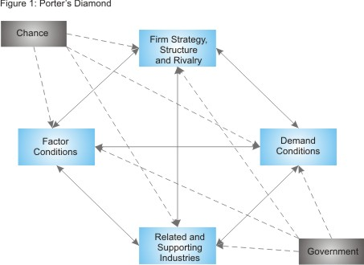
Literature review
Industrial competitiveness theory
Porter's diamond theory believes that whether a specific industry is competitive is affected by six factors, including four direct factors: factors of production, demand conditions, the state of related and auxiliary drives, business strategy and structure and competition, and two crucial (additional) factors: government and opportunities.
Michael Porter's National Diamond
Source: Porter’s Diamond Shaping Your Strategy to Reflect National Strengths and Weaknesses
Notes:
In 1990, Michael Porter, a professor at Harvard University, put forward the diamond model theory from competitive advantage. Porter's diamond theory provides a relatively complete analytical framework for industrial development with a solid systemic nature. Porter's diamond theory believes that whether a specific industry is competitive is affected by six factors, including four direct factors: factors of production, demand conditions, the state of related and auxiliary drives, business strategy and structure and competition, and two crucial (additional) factors: government and opportunities.

Slide 12
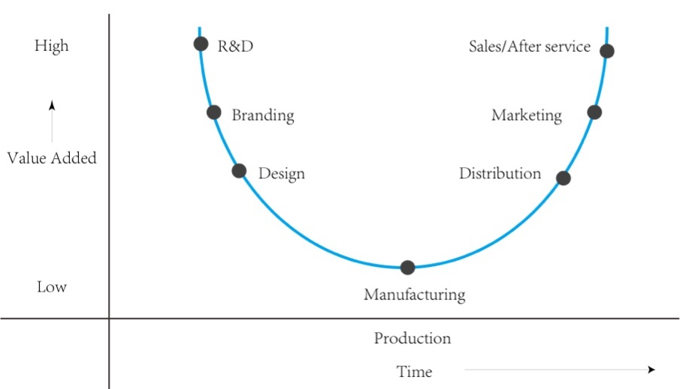
Literature review
Smile Curve Theory
In 1992, the Chairman of Taiwan Acer Group, Stan Shih, proposed the "Smile Curve” (Business Growth Strategies for Asia Pacific,1992) to describe the changes of the added value of each link in the personal computer manufacturing process based on Michael Porter's value chain model and his many years of experience in the IT industry.
Smile Curve
Sounce：Source: Status and trends in the global，2018
Notes:
In 1992, the Chairman of Taiwan Acer Group, Stan Shih, proposed the "Smile Curve” on its publiciation named Business Growth Strategies for Asia Pacific to describe the changes of the added value of each link in the personal computer manufacturing process based on Michael Porter's value chain model and his experience in the IT industry. The Smile Curve is a comprehensive display of the various links in the industrial chain, reflecting the value-added of different links in the form of a parabola, and has become a fundamental theory to guide the direction of industrial upgrading. The "smile curve" is a smile-shaped curve with high and low levels at both ends, describing the value-added level of each link in the industrial chain.

Slide 13
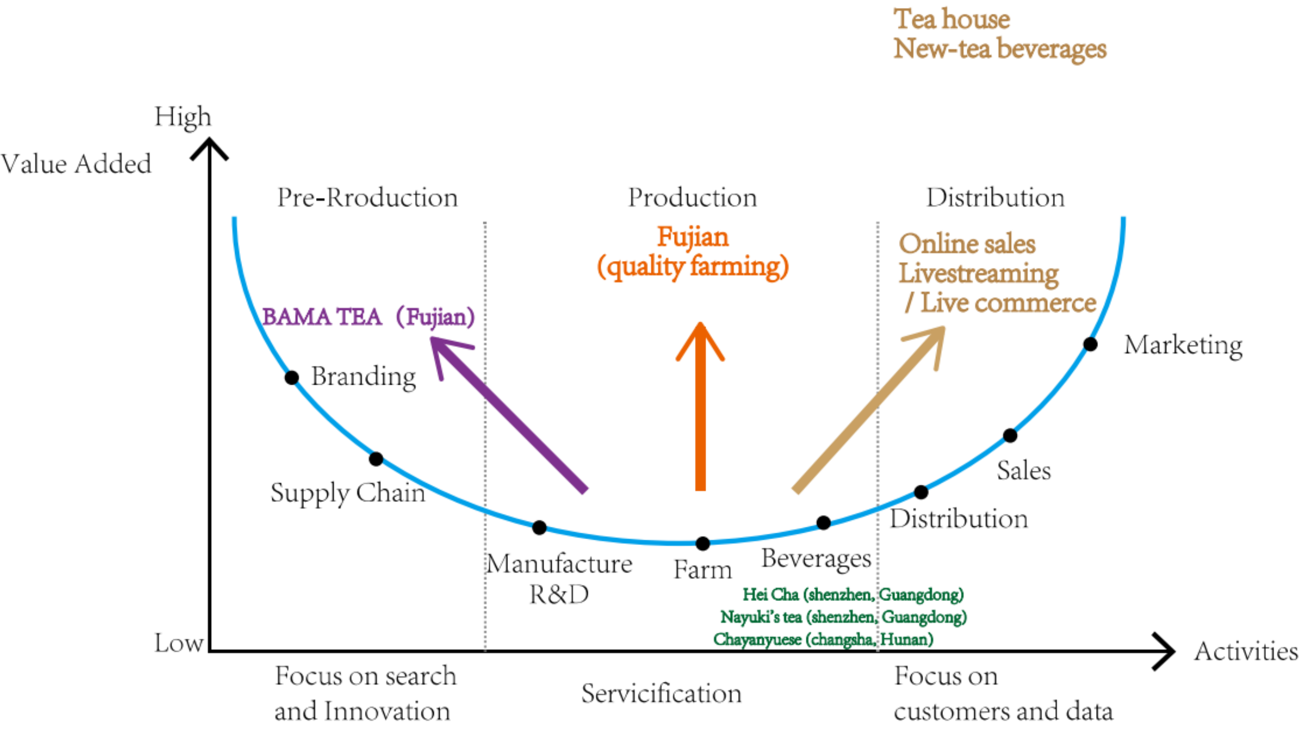
Preliminary Analysis
Smile Curve Theory
Distribution:
integrate online and offline sales platforms
live-streaming with goods sales mode
Teahouse building like Shanghai…
Production:
new-style tea beverages
Pre-production:
make full use of technological advances to reduce production costs and improve product quality
incorporate Fujian tea culture and fashion elements into product design and packaging
the smile curve for tea industry
Adapted from: World Investment Report,2020
Notes:
Based on literature and theory review, this study establishes a smile curve model for the tea industry.
In terms of distribution, we integrate online and offline sales platforms with the help of internet, develop sales channels, and introduce the live-streaming with goods sales model; we can also follow the teahouse business that is flourishing in Beijing, Shanghai, and Chengdu to combine the tea industry with cultural values, to build the service industry, and to develop new distribution channels.
For production, we will concentrate on the technical improvement of tea quality, and optimize the producing and technological process through technical research and development to maintain Fujian's leadership in tea quality. In the face of the widespread demand for new tea beverages, we may launch new tea beverages as a sub-brand. In terms of pre-production, R&D staff should always pay attention to the development trend of the tea industry, making full use of technological advances to reduce production costs and improve product quality, and integrating Fujian tea culture and fashion elements into product design and packaging by merging the needs of current consumer groups in the design segment.

Slide 14
Research method
Qualitative Research
Literature Analysis ：
industrial economic theory, industrial transformation and development theory, industrial competitiveness theory, and smile curve theory
focuses on the business model transformation and upgrading of traditional tea enterprises in Fujian to enhance their competitiveness from the perspective of value-added enhancement.
In-depth interview ：
Anxi County, the birthplace of Tie Guanyin Oolong Tea
Wuyishan Tea Production Area, which has "Da Hong Pao ”
five leading enterprises and tea industry association and tea farmer associations
Chengdu Teahouse Association
Anxi Agricultural Government
Notes:
This study is a qualitative study. To ensure the accuracy of data, based on the previous literature review, this study will conduct further in-depth interviews and cross-validation to fill in the data gaps where literature data are not available.
This study is a semi-structured and in-depth interview with two of the most representative tea production areas in Fujian, namely Anxi County, the birthplace of Tieguanyin Oolong Tea, and Wuyishan Tea Production Area, which has "Da Hongpao Black Tea" as its characteristic industry. These two main tea production areas were used as the center of research to visit the five leading enterprises as well as tea farmers' associations; Anxi Agriculture government is in charge of all tea agricultural industries, was also the target of the interview. For there is no such official teahouse association in Fujian, the Chengdu Teahouse Association is the representative of the Chinese Teahouse Association, thus this study decided to interview the Chengdu Teahouse Association by on-line interview.

Slide 15
Semi-structure interview
Interviewees | Guiding Question for Semi Structure Interview
Top 5 leading company of Fujian’s tea industry | At present, under the influence of COVID-19, is foreign exports affected? And is there a shift to domestic sales? Whether we have to face more competitive pressure?
 | Facing the homogenization competition of major domestic tea companies, how can you enhance the competitiveness of your products? In what ways have you tried to do so?
 | Have you considered developing the whole tea industry chain? For example, establish your own sub-brand of new tea beverages brand? Or cooperate with new tea companies such as Hei Cha and Naiyuki’s tea?
Notes:
Here are guiding questions for semi structure interview I listed. For the top 5 leading company of Fujian’s tea industry, we may focus on the facing challenges after covid-19. whether the foreign exports affected? And is there a shift to domestic sales? And if they decide to shift to domestic market, whether they are going to face more competitive pressure especially for the homogenization competition of their products. Have they considered developing the whole tea industry chain?
For example, establish their own sub-brand of new tea beverages brand?

Slide 16
Semi-structure interview
Farmer associations | Are there any improvements in the production process and quality of tea planting compared to the past?
Tea industry association | Is there any cooperation with the government or universities in production, processing, marketing and R&D? If so, what kind of cooperation is there?
Teahouse business associations | Teahouse industry is a characteristic industry in Chengdu, but compared with teahouses business in Beijing, Shanghai, Hangzhou and other places, Chengdu teahouses lack brands. In order to promote the branding and chain development of Chengdu teahouses, and to promote the cross regional development of Sichuan style teahouses and move towards the whole country, are there any attempts?
Local government | Does the government have any policy or financial support to promote the brand building of Fujian tea industry?
Notes:
For the tea industry associations, I am interested in some R&D cooperation of their innovation system formed with government, companies and universities.
As for the teahouse business associations, in order to promote the branding and chain development of Chengdu teahouses, then to promote the cross regional development of Sichuan style teahouses and move towards the whole country, are there any attempts? Whether they are facing some challenges?
For local government, Does the government have any policy or financial support to promote the brand building of Fujian tea industry?

Slide 17
Research Framework
Analyze the development bottlenecks of traditional tea enterprises in Fujian
the theory of agricultural industry
the theory of industry transformation
Distribution
the theory of smile curve
The theory of Smile Curve
(theoretical framework )
Production
Pre-production
the transformation and upgrading of business model of Fujian tea industry
Notes:
To conclude, this study will analyze the development bottlenecks of traditional tea enterprises in Fujian based on agricultural industry theory, industry transformation theory and smile curve theory. From the perspective of enhancing the value-added of traditional tea industry and using "smile curve" as the theoretical framework, we will propose development hypotheses and feasible solutions for the transformation and upgrading of the business model of Fujian tea industry from three aspects of distribution, production and pre-production respectively.

Slide 18
References
M.W. Van Alstyne, G.G. Parker, S.P. Choudary, Pipelines, platforms, and the new rules of strategy, Harvard Business Review. 62 (2016) 54-60.
Marshall A.Principles of Economics[M].london：Maillan.1920：1877-1890 Stevens and Graham.Integrating the Supply Chain[J].International Journal of Physical Distribution and Material Management，1989，19(8)：3-8.
Mighell ， Ronald L ， Lawrence A Jones.Vertical coordination in agriculture[D]. Washington：U.S.Dept.of Agr，1963：90-93.
Pratap K.J.Mohapatra1，Madhab C.Bora，Kailas C.Sahu. Incorporating Delphi results in system dynamics models ： A case of Indian tea industry[J].Technological Forecasting and Social Change，1984，25(2)： 159-177.
M Bhuyan，S Borah. Use of Electronic Nose in Tea Industry[M].India Assam：Tezpur University Press.2001. [91]Mahesh N. Economic constraints facing the Indian tea industry： Strategies for the post-WTO era[J]. Agricultural Economics Research Review，2001，14(1)：209-219.

