Slide 1
Current Situation of Reusable Packaging in Taiwan’s E-commerce Industry
Amy Sun_December 28

Slide 2
Table of contents
01
02
03
04
Introduction
Reduction
Efforts
Interview
Comparison
Situation in Taiwan
Reduction alliance, label, guidelines, and pilot program
EPA, MOEA, PackAge+
Interview results and perspectives
EU vs. Taiwan
RePack vs. PackAge+
EPA vs. PackAge+
Perspectives

Slide 3
What is going on?
online shopping
100 million packaging boxes
240 billion NTD
Introduction
reduction guidelines (2019)
oversized package waste
These are data of year 2019.
Notes:
Consumer behavior changes, people choose to shop online
In 2019, the revenue of E-commerce industry reached 240 billion
Generated 100 million packaging boxes and 34 thousand tons of packing paper.
These then turned into oversized package waste that continuously harming the environment.
To deal with it, Taiwanese government launched out reduction guidelines in 2019.

Slide 4
Table of contents
01
02
03
04
Introduction
Reduction
Efforts
Interview
Comparison
Situation in Taiwan
Reduction alliance, label, guidelines, and pilot program
EPA, MOEA, PackAge+
Interview results and perspectives
EU vs. Taiwan
RePack vs. PackAge+

Slide 5
Reduction Efforts
Online Shopping Packaging Reduction Alliance
EPA formed an alliance with
E-commerce
Platforms
Packaging
Industry
Logistic
Industry
PChome, Shopee, momo, Yahoo 奇摩購物中心, 博客來, 生活市集, 神腦生活, 台塑購物網, IKEA, 台糖易購網
PackAge+ and some other traditional packaging companies, such as
利豐包裝材料有限公司,
川金企業有限公司
台灣宅配通股份有限公司
Notes:
There are three kinds of stakeholders in the alliance (e-commerce, packaging, and logistic.)
The purpose of this alliance is to include e-commerce platforms who are under guidelines control, and also packaging technology, and logistic.
To include all of the stakeholders so that they can exchange their perspectives in the meeting.
有成立一個網購包裝減量聯盟，其中包含網購平台業者、物流業者、包材業者，有這樣的聯盟是希望說在一個政策的推動裡面，除了有受管制的對象以外，還有技術的部分物流的部分。技術要可行，政策要可以落實，所以我們這個聯盟成員才會是這樣子，可以一次把他們全部找來。

Slide 6
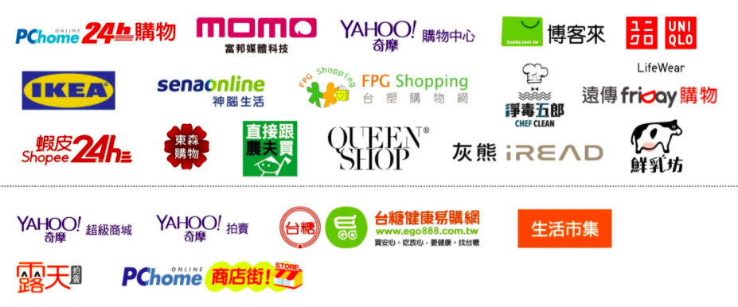
Reduction Efforts
Online Shopping Packaging Reduction Label
E-commerce platform can apply for the label

Slide 7
Online Shopping Packaging Reduction Guidelines
Reduction Efforts
(網購包裝減量指引)
Packaging Usage Reduction | (Once received the label, the following requirements should be done before 2019) The packaging materials(e.g. boxes) should weigh under 10% of the package’s total weight. The tape should not be longer than twice and a half of the sum of the package’s length.
Eco-friendly Materials | (Once received the label, the following requirements should be done before 2020) The packaging materials should be single material.(e.g. paper or PE) Packaging boxes/bags should be made from 100% recycled paper or plastic that consists of at least 25% recycled plastic. The boxes should remain its original color, and the printing area on boxes/bags should be under 50%. Packaging boxes/bags, buffering, taping should not use PVC materials.
Reusable Packaging | (Once received the label, the following requirements should be done before 2022) Use “reusable packaging boxes/bags”, and the using rate of reusable packaging boxes/bags should increase to 10%.
Guidelines from EPA(Environmental Protection Administration)
Notes:
There are three aspects in this reduction guideline.
First is to reduce the usage of packaging materials.
Second is to replace the packaging materials with the eco-friendly ones.
And the third is to encourage the e-commerce platforms to use reusable packaging instead of the one-time only disposable ones.

Slide 8
Reduction Efforts
Packaging Usage Reduction | To use the packaging box/bag to the greatest extent. To limit the usage of tape.
Eco-friendly Materials | Single material. Reduce the printing area on the box.
Reusable Packaging | Encourage the E-commerce platforms to use reusable packaging.
Voluntary agreement
No coercive force
CSR

Slide 9
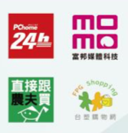
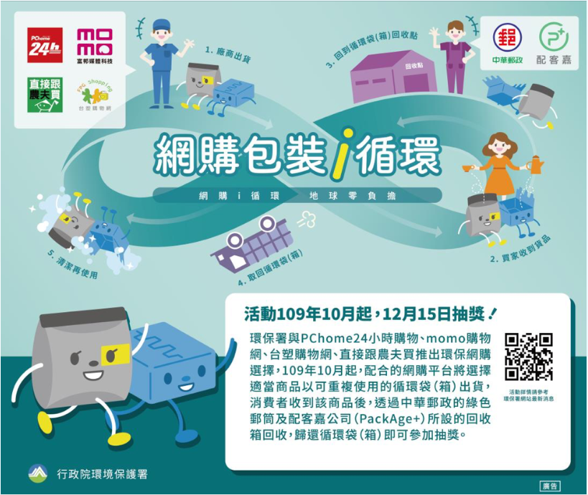
EPA Pilot Program (2020)
Reduction Efforts
4 E-commerce platforms
PackAge+ & Chunghua Post
Use reusable
packaging
E-commerce platforms
Consumers
Provide
packaging
Return
packaging
Collect
packaging
Third-party reusable packaging providers
Return points
Collect
packaging
2020, 10/1-11/30
Total shipments using reusable packaging: 8,241
Returned reusable packaging: 2,067
Return rate: 25%

Slide 10
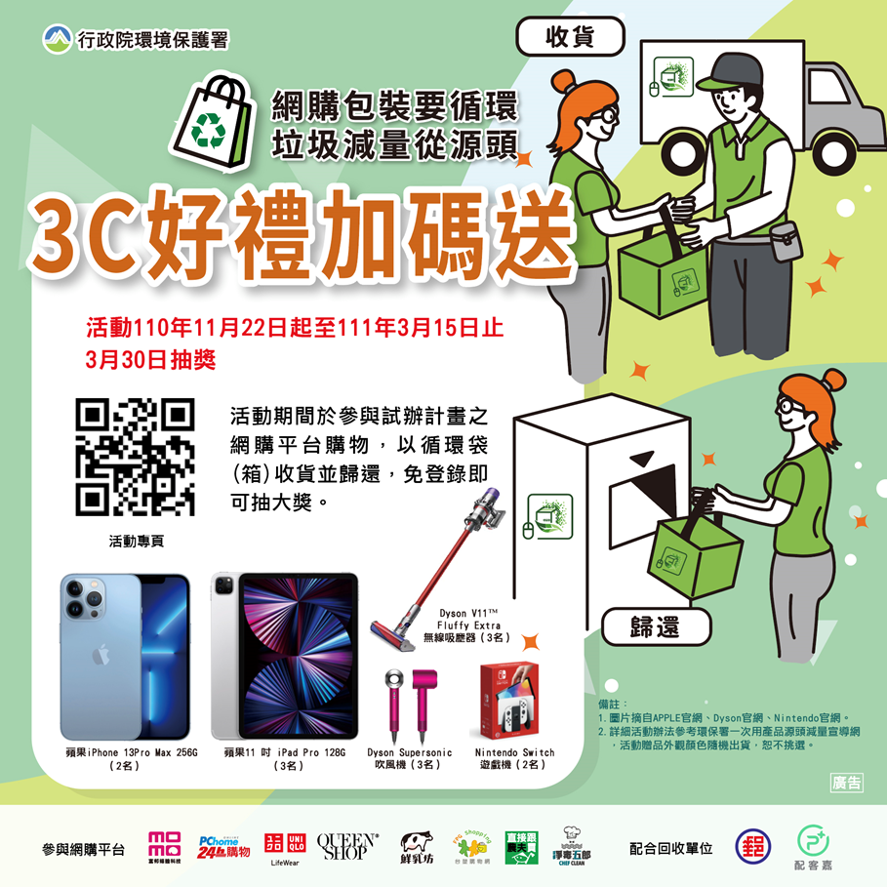
EPA Pilot Program (2021)
Reduction Efforts
Consumer can decide on their own.
Apply a new system on E-commerce platforms.
Adjustments on order processing procedures.
Fulfill the various needs of commodities.
Encourage platforms to develop multiple sizes of packaging bags.
Design and develop reusable packaging boxes.
Increase the convenience of returning packaging.
Expand the cooperation of return points.
To evaluate the feasibility of “using convenience stores as return points.”
8 E-commerce platforms
PackAge+ & Chunghua Post
The program is ongoing.
Notes:
There are three improvements:
The E-commerce platforms have to let consumers decide on their own. Consumer can choose to use a reusable packaging or not.

Slide 11
Table of contents
01
02
03
04
Introduction
Reduction
Efforts
Interview
Comparison
Situation in Taiwan
Reduction alliance, label, guidelines, and pilot program
EPA, MOEA, PackAge+
interview results and perspectives
EU vs. Taiwan
RePack vs. PackAge+

Slide 12
Interviewees
Interview
EPA
(Environmental Protection Administration)
Recycling Fund
Management Board
環保署 資源回收管理基金管理委員會
MOEA
(Ministry of Economic Affairs)
Bureau of Industry
Sustainable Development Division
經濟部工業局永續發展組
PackAge+
(a packaging company)
Business Development Senior Manager
商業開發資深經理
Notes:
環保署資源回收管理基金管理會，
技正負責的網購包裝減量，則是歸在推動包裝減量專案計畫下的其中一件子計畫。
經濟部工業局 永續發展組
商業開發資深經理

Slide 13
Guideline’s Purpose
Interview
Find a feasible business model.
Use a regulatory framework to lead consumers toward sustainability and change their shopping habits.
Encourage the packaging industry to develop innovative products.
In the beginning of the pilot program, use subsidy and lucky raffle as incentives.
The result of EPA pilot programs in 2020 & 2021 does not mean that this business model will sustain and be used in the future.
Notes:
宗旨
希望透過計劃找到合理可行的商業模式
透過政府政策去引導消費者使用習慣改變以及業者產品創新
初期透過補助、抽獎
這兩年的試辦計畫並不代表未來這個商業模式就可以存續， 需在各階段檢討調整

Slide 14
Guideline’s Implementation
Interview
Using weight ratio as the reduction measurement is not an exact standard.
(Packaging utilization rate: 90% is product weight, 10% is packaging weight)
Tiny or thin products cannot fulfill the requirements. (Scale classification is needed)
It is hard to use volume as standard.
Warehouses are automated, but the product volume need manual measuring.
Warehouses are lack of products’ precise information, such as volume.
The guideline might become law.
Notes:
實施情況
重量比值並非完美的量測基準
包裝利用率：90%的產品重量對應10%的包裝重量 (例：輕或小型產品無法達到重量比值)
標準參考美國紐約包裝減量指引
需要以商品重量做分級規範 Scale classification
無法以體積作為基準
需人工量測manual measuring，現平台倉儲多為自動化
倉儲缺少商品體積、大小等資訊
未來有法制化的可能
評估循環包裝示範計畫 (網購i循環) 的結果

Slide 15
Reduction Data
Interview
 | 2019 | 2020 | 2021
Average packaging weight (kg/per item) | 0.322 | 0.285 | 0.275
Yearly reduction (ton) | - | 2344 | 1700 (Q1-Q2)
Does the reduction data meet social expectations?
Fail to see the whole picture of the waste.
The usage of packaging box in B2B logistic is 5-7 times higher than in E-commerce industry.
Notes:
沒有符合社會期待？
沒有看到廢棄物全貌 ，網購包裝的包裝紙箱用量並非最大
網購包裝紙箱只有企業對企業出貨用量的5分之一到7分之一

Slide 16
EPA Pilot Program
Interview
Problems:
1. Consumers don’t know the packaging is reusable. (return rate: 25%)
Government’s fault: not enough publicity.
E-commerce platforms’ fault: consumer cannot decide reusable or not. Did not widely propagate the pilot program.
2. Even if the E-commerce platforms are under regulative control, consumers might not willing to follow the regulation.
Through pilot programs, gradually change the social atmosphere.
Solution: make some changes on the subsidy requirements
Notes:
問題
消費者不知道會拿到循環袋箱
政府宣傳不夠
網購平台沒有加強宣導 (主因)
（產品選擇使用循環袋箱有難度，所以沒有辦法大肆宣傳）
規定沒有辦法直接對管制對象要求，然後民眾就願意去配合辦理 （透過一些示範，出現一定的成效，然後讓社會氛圍改變 ）

Slide 17
EPA Pilot Program
Interview
Total Subsidy $: 2.2 million
Subsidies are for E-commerce platforms only
Changes on subsidy requirements:
1. Build the system that consumers can select reusable /traditional packaging.
- Reusable packaging section
- Eco-friendly membership
2. Subsidy on packaging production and design.
Subsidy $: 600 thousand
In year 2020, it was 90% & 40%
Subsidy $: 1.6 million
 | $ | $ Distribution formula
Reusable Packaging Shipment | 960 thousand (1.6million x 60%) | 960 thousand x $\frac{its own shipment amount}{total shipment amount of all platforms}$
Reusable Packaging Return | 640 thousand (1.6million x 40%) | 640 thousand x $\frac{its own return amount}{total return amount of all platforms}$
Notes:
改變
是否能自由選擇使用循環包裝
補助回收比例提高
（假設有100萬，60萬拿去做出貨，40萬拿去做回收）
已加入網購包裝減量聯盟及取得網購包裝減量標章。
於網購平台網站「首頁」明顯處宣傳循環袋(箱)，並露出本署抽獎活動的訊息，以利鼓勵消 費者回收，擴大推動效益。
配合本署推動期程，110年推動日起至111年3月15日 期間皆提供循環袋(箱)服務
循環袋(箱)不得以贈品形式提供給消費者。

Slide 18
EPA Perspectives
Interview
GDP in Taiwan is lower than in Europe, so when the cost of reusable packaging is the same, people feel differently.
Reusable packaging seems to be more costly, thus it’s more challenging to promote the idea of reusable packaging in Taiwan.
None of the CE model is created by government.
Improve the convenience of returning the reusable packaging.
Increase the return points.
Vary the size and specification of the reusable packaging.
Take national conditions into account.
The cost of reverse logistics is 3 times higher than forward logistics.
(If the reusable packaging box/bag weigh 10% of the product, a truck with 100 kg products will return with 10 kg weight. )
Notes:
台灣的GDP比歐洲低，更具挑戰，同樣是十塊錢的成本底下，在民眾的使用上負擔是不一樣的
會有越來越多這種第三方租賃的平台出現
任何的循環模式都不是政府建立的
循環袋箱的回收便利性、回收的站點
循環箱袋的規格
要考量國情，還有在地化
逆物流的成本是比正物流高三倍
箱子原本有裝產品，產品一定比較重，所以出去的時候，假設產品出貨的箱子一車可以裝100公斤，可是要回來的時候，單純是為了紙箱而回來的時候，即便箱子可以折起、收起來，可是這些箱子把它全部塞起來，塞到整車會可以到100公斤嗎？
假設我今天箱體只佔產品10%德重量的話，換句話說一車可出貨100公斤的產品，回來可能只有10公斤的重量。
對於這個物流業者的話，這個成本，同樣花一樣油錢，卻只能載十分之一重量的東西回來，這樣當然是成本的增加。
然後再加上可能不是只有一個回收點，逆物流可能甚至不只是正物流的三倍。物流業者有一個協會聯盟，裡面的專家說差不多是三倍。

Slide 19
Circular Economy
Interview
Circular Economy Promoting Plan (循環經濟推動方案)
Promoting the innovation of new materials (推動新材料研發及專區)
Circular industry science park (新材料循環產業園區)
Energy resources integration (能資源整合與產業共生)
Green consumption and transaction (綠色消費與交易)
renewable flows
management
stock management
biochemical feedstock
recycle
regeneration
share
refurbish/ remanufacture
reuse/redistribute
biogas
cascades
maintain/prolong
anaerobic digestion
extraction of
biochemical feedstock
Focus on heavy industry and the promotion of reusing waste disposal, such as steel slags.(鋼爐渣) But no CE model or promotion on E-commerce industry.
EPA is in full charge of this.
Definition of CE: Butterfly Diagram from Ellen MacArthur Foundation
Notes:
4 strategies
『綠色交易與產業共生加速「循環產業化」推廣全國，實現資源的永續效益』

Slide 20
Bureau of Industry
Interview
Collaboration with EPA happens only on the meeting held by CEPO (Circular Economy Promoting Office).
Issues on industrial area, production of firms, and the regulation loosening.
Did not provide subsidy for EPA pilot plans.
Subsidize the innovation of technology: 5G, AI, automation, industry promotion.
Subsidy for PackAge+ might be provided by: Department of Technology (技術處) or Small and Medium Enterprise Administration (中小企業處)
CE related business in Taiwan now focuses on rental services, but not much on product designing.

Slide 21
Business Model
Interview
Third-party packaging provider (buy or rent)
Reusable for 50 times
Recycled PET material
Reduce 1.2 kg carbon emission (packaging production + burn after recycled)

Slide 22
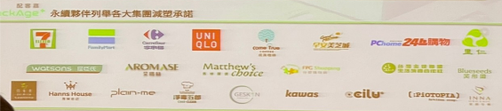
Sustainable Partnership
Interview
E-commerce platforms, such as Pchome, Uniqlo, Aromase…
Return points, such as 7-11, FamilyMart…

Slide 23
Incentives
Interview
Eco-friendly brands: second-hand clothes, eco-friendly selection store…
Big company: CSR, GHG emissions target…
Gain good publicity among consumers.
Have been PackAge+’s partner from the very beginning.

Slide 24
Perspectives
Interview
Reverse logistics might be costly in the beginning, but can utilize the forward logistics in the future. (After delivered the packages, truckdriver can also pick up the reusable packaging.)
Return points set in partner shops or convenience store. When returning packaging, people can also consume in the store. (Win-Win-Win situation)
Retailers need pressure from government, so the guideline served as a stimulation.

Slide 25
Table of contents
01
02
03
04
Introduction
Reduction
Efforts
Interview
Comparison
Situation in Taiwan
Reduction alliance, label, guidelines, and pilot program
EPA, MOEA, PackAge+
Interview results and perspectives
EU vs. Taiwan
RePack vs. PackAge+
EPA vs. PackAge+
Perspectives

Slide 26
EPA
Comparison
PackAge+
Government
Regulatory framework
Use subsidy & raffle as incentive.
Reverse logistics: negative attitude
Reduction > Reuse
Business
Partnership, funding
Integrate the service of return points, create win-win situation.
Reverse logistics: positive attitude
Reduction < Reuse

Slide 27
RePack
Comparison
PackAge+
Finland, EU
Buy the packaging
Post Office
Three sizes of bags
Barcode system, cleaning system
Taiwan
Buy or borrow the packaging
Return points, create win-win situation.
Five sizes of bags and also boxes
Barcode system, cleaning system

Slide 28
Future Work
Go through CSR report of PackAge+’s partners, such as Uniqlo, Pchome… (carbon emission reduction, green investment…)
Analyze the “sustainable partners” (platforms and return points) and their incentives
Interview with PackAge+’s sustainable partners (eco-friendly brands, big companies, return point stores)
Comparison (EU vs. TW, EPA vs. PackAge+, RePack vs. PackAge+)

Slide 29
Thanks

